Slide 1
PROJECT TIME MANAGEMENT

Slide 2
Components of Project Time Management
Plan schedule management
Define activities
Sequence activities
Estimate activity resources
Estimate activity durations
Develop schedule
Control schedule

Slide 3
Defines how the schedule will be:
Developed
Managed
Executed
Controlled
Defines schedule management approach for entire project

Slide 4
“Activity” Defined p. 698 PMBOK 6th ed
A distinct, scheduled portion of work performed during the course of a project.

Slide 5
Schedule Management Plan defined
A component of the project management plan that establishes the criteria and the activities for developing, monitoring, and controlling the schedule.

Slide 6
“Activity List” Defined PMBOK, 6th ed. p. 698
A documented tabulation of schedule activities that shows the activity description, activity identifier, and a sufficiently detailed scope of work description so that project team members understand what work is to be performed.

Slide 7
More on “Activities” (1)
Activities typically have a “verb-noun” format; but this is not necessary
Milestone activities typically have zero duration; but this is not necessary
(1) https://www.pmlearningsolutions.com/blog/work-package-versus-activity-pmp-concept-14

Slide 8
“Define Activities” PMBOK 6th ed 704
The process of identifying and documenting the specific actions to be performed to produce the project deliverables.

Slide 9
Contents of Define Activities
Project work and project manager work
Planning processes
Sequence of activities
Procurement time
Internal and external events
Known and unknown events

Slide 10
Milestone Defined (see next slide)
“A significant event point or event in a project, program, …” (PMBOK 6th ed, p711)
When adding a milestone to MS Project, we typically give it a duration of 0, and it typically marks the start or end of a group of related activities. (BV)

Slide 11
More on Milestones (derived from Wikipedia)
“Milestones are tools used in project management to mark specific points along a (project’s) timeline. These points may signal anchors such as a project start and end date, a need for external review or input and budget checks, among others. In many instances, milestones do not impact project duration (that is they often have a duration of zero). Instead, they focus on major progress points that must be reached to achieve success.”
Milestones are one of the tools that assist project managers to “determine whether or not the project is on schedule.”
Some project managers use milestones only on the critical path. This practice can lead to the team ignoring non-critical path tasks during monitoring and controlling, which can lead to non-critical path items to putrefy and thus becoming problematic. The takeaway here is do not disregard tasks that are not on the critical path, or they can force themselves onto your critical path (in a bad way).

Slide 12
Rolling Wave Planning
Imminent work planned out in more detail than distant work

Slide 13
Sequence Activities(bv)
Team activity
Establishing dependencies is VERY important
People need to know who is counting on their ability to complete an activity and why.

Slide 14
Mandatory vs. Discretionary dependencies (p. 191)
Mandatory: “Legally or contractually imposed”
Discretionary: Dependencies: based on organizational best practices

Slide 15
Reserves (p. 202)
Contingency reserve: for identified risks
Management reserve: time set aside for currently unidentified risks.

Slide 16
Predecessor vs Successor (BV)
Given we are focusing on “Task B”; “Task A” is the “predecessor of “Task B”, and “Task C” is the “Successor” of “Task B”
Task A is Task B’s “Predecessor”
Task C is Task B’s “Successor”
Task A
Task B
Task C

Slide 17
Dependency Defined
As this is not well defined in the PMBOK 6h Ed. glossary, so an alternative source for this definition is used. https://www.projectinsight.net/project-management-basics/task-dependencies

Slide 18
PMBOK’s definition of dependency is so poor it is not worth mentioning here.

Slide 19
Duration vs. Effort (bv)
Effort and duration are not the same thing!
Duration is how long it takes your team to complete an activity; this is calendar time. The more members on your team, until diminishing returns sets in, the shorter the duration.
Effort is how many hours you will bill to the project.
Effort-hours = Team-member-#1’s-hours + Team-member-#2’s-hours + Team-member-#3’s-hours + Team-member-#4’s-hours …

Slide 20
Example Duration vs. Effort
2
Tom spends 2 hours every day for 5 days on activity#45
The duration of this task is:
The effort is:
5 days.
10 hours

Slide 21
Precedence Diagramming Method (see next 4 slides)
A
B
A
B
Finish-to-Start
Start-to-Start
A
B
A
B
Finish-to-Finish
Start-to-Finish
Notes:
For more information on this topic see the PMBOK Guide 6.3.2.1.

Slide 22
Finish to Start
“A logical relationship in which a successor activity cannot start until a predecessor activity has finished. For example, installing-the-OS-on-a-PC(successor) cannot start until the PC-hardware-is-assembled(predecessor)”. PMBOK P 190 6th ed.
This is the most common type
Notes:
6.3.2.1

Slide 23
Start to Start
“A logical relationship in which a successor activity cannot start until a predecessor activity has started. For example, level concrete (successor) cannot begin until pour-foundation (predecessor) begins.” PMBOK 6th ed. P 190. (For those of you who have no clue what concreate leveling is, please see the next 2 slides)
Notes:
6.3.2.1

Slide 24
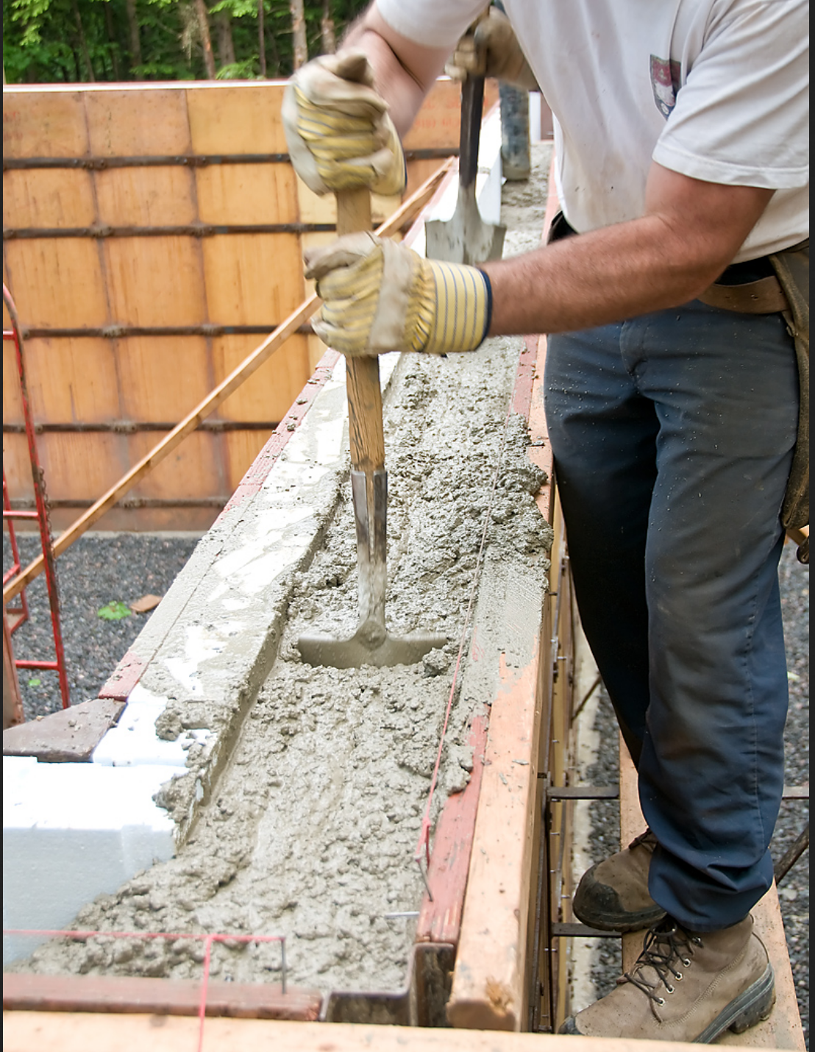
Start to Start cont.
Concreate is being poured in through this pipe as workers “level*” it
More concreate is needed to fill this space, but work on ”leveling” started before all the concreate was poured.
Clipart.com
*“Concreate Leveling” defined by Brian: when concreate is first oozed into a fixed shape (the shape determines the configuration of the solid formed by the concreate once it hardens), it has an un-even surface. Leveling is the process of making the surface flat. Usually flat pieces of metal, called “trowels” are used to do this “level” the concreate. See next slide.

Slide 25
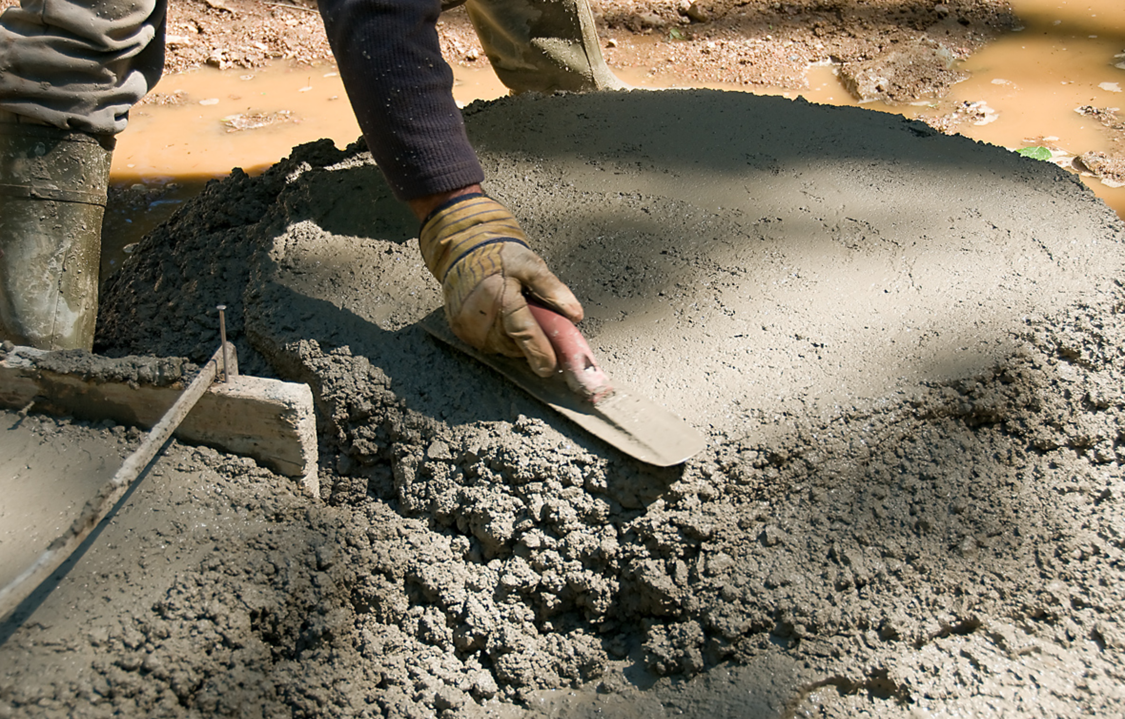
This is what a trowel looks like. It is being used to “smooth out” the surface of the cement.
Start to Start cont.
A trowel

Slide 26
Start to finish
“A logical relationship in which a successor activity cannot finish until a predecessor activity has started. For example, a-new-accounts-payable-system (successor) has to start before the old-accounting-payable-system(can be shut down (predecessor).” PMBOK P 190 6th ed.
(In this slide, “system” can be taken to mean “computer application”)
For further clarification see: https://www.youtube.com/watch?v=zeS6XJQTZXE
Notes:
6.3.2.1

Slide 27

Finish to Finish
“A logical relationship in which a successor activity cannot finish until a predecessor activity has finished, For example, writing-a-document (predecessor) is required to finish before editing-the-document (successor) can finish”. PMBOK p 190 6th ed.
Notes:
6.3.2.1

Slide 28
Critical path
The critical path has no free time on it.
The Critical path identifies the minimum time that a project will take, and, the activities that compose the critical path.
Activities that are not on the critical path(s) contain available time.
https://www.youtube.com/watch?v=0Lo4zsB-bjE
https://www.youtube.com/watch?v=4oDLMs11Exs
http://terms.ameagle.com/2011/01/what-is-Activities-what-is-float-is-there.html

Slide 29
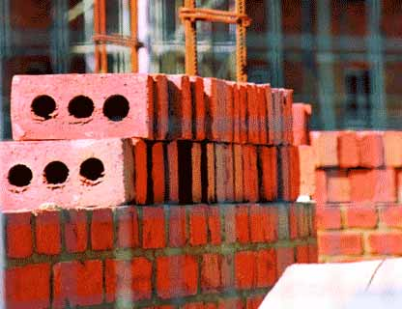


6.4 Estimate Activity resources
Resources to complete activities
People
Equipment
Materials
Facilities

Slide 30
Resource Availability Issues
Negotiate for resources
Delay the activity or project
Find alternative resources
Notes:
For more information on this topic see PMBOK Guide 6.4.1.4.

Slide 31
Factors impacting estimation (p. 197)
Law of diminishing returns: at some point more inputs do not create more outputs, and if taken to an extreme, even more inputs can reduce overall output.
Advances in technology: Can reduce duration estimates
Motivation of staff:
Parkinson’s law: Work tends to expand to fill the time available
Procrastination: teams can postpone significant effort until the due date.

Slide 32

Analogous Estimating
Creates an analogy
Similar project work
Historical information
Top-down estimating
Notes:
For more information on this topic see PMBOK Guide 6.5.2.2.

Slide 33
Parametric Estimating
Parameter for estimating
Repetitive work
“An estimating technique in which an algorithm is used to calculate cost or duration based on historical data and project parameters.” Regression analysis is good for this.
Notes:
For more information on this topic see PMBOK Guide 6.5.2.3.

Slide 34
PERT Estimates
Program Evaluation and Review Technique
Also called beta distribution
(O+(4ML)+P)/6=estimate
(25+(4x45)+75)/6=46.66 hours
Notes:
For more information on this topic see PMBOK Guide 6.5.2.4.

Slide 35
Three-Point Estimates
Finds an average of
Optimistic
Most likely
Pessimistic
Also called triangular distribution
(O+ML+P)/3=estimate
(25+45+75)/3=48.33 hours
Notes:
For more information on this topic see PMBOK Guide 6.5.2.4.

Slide 36
6.6 Develop Schedule
Defines the sequence of events
Durations of the activities and project
Determines when resources are needed
Establishes logical relationships between activities

Slide 37
Risks and the Schedule
Risk is an uncertain event or condition
Knowns and unknowns
Risk analysis affects completion
Risk affects costs and time
Notes:
For more information on this topic see the PMBOK Guide 6.6.1.9 and 11.2.3.1.

Slide 38
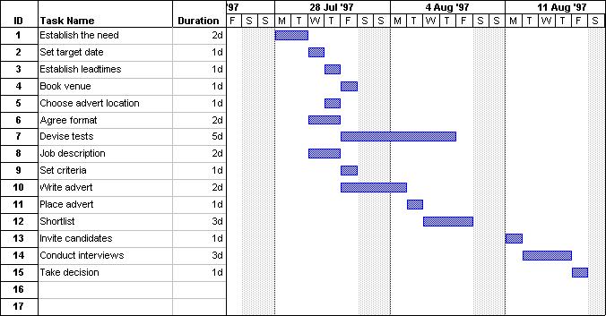
Determining the Project Timeline
Gantt charts are pretty typical. This looks very similar to the default on MS Project.
Notes:
For more information on this topic see the PMBOK Guide 6.6.2.1.

Slide 39
Using Resource Leveling Heuristics
Limits labor in time period
Often extends the project schedule
40 hours max
Notes:
PMBOK 6.5.2.4

Slide 40
Critical path defined
The sequence of activities determining the minimum time for the project to complete
Given all the possible paths through the Gantt Chart to complete a project, this is the longest of all the possible paths.
Example: if you add one day to the duration of the critical path, you add one day to the duration of the project.

Slide 41
Schedule Compression: Crashing (important)
Crashing adds recourses (staff, hardware, etc.), at an additional cost to the project, to the critical path to reduce the duration of the project. A caution here is that after some point, either diminishing returns will set in, or, you will have another critical path (that you will then need to crash) (BV)
Crashing (p 703 6th ed. PMOBOK) “A technique used to shorten the schedule duration for the least incremental cost by adding resources.”
Notes:
For more information on this topic see the PMBOK Guide 6.6.2.4..

Slide 42
Schedule Compression: Fast Tracking (important)
Fast tracking overlaps project schedule paths to reduce the overall duration of the project. (bv)
Fast Taking (PMBOK 6th Ed, p. 706): “A schedule compression technique in which activities or phases normally done in sequence are performed in parallel for at least a portion of their duration”
Notes:
For more information on this topic see the PMBOK Guide 6.6.2.4..

Slide 43
Measuring project performance
Value tied to percentage of work completed
Planned value – what the project should be worth
Estimate to complete
Milestones
Key deliverables

Slide 44
How to do MS Project Video
https://www.youtube.com/watch?v=0CiaW_d4GBg&t=337s

Slide 45
End

